Slide 1

6th Grade Accelerated Math
Unit 2, Lesson 6 Solving Two‑Step, Real-World Problems with Fractions or Decimals Volume 1, pg. 64

Slide 2


Benchmark
MA.6.NSO.2.3 Solve multi-step, real-world problems involving any of the four operations with positive multi-digit decimals or positive fractions, including mixed numbers.
volume 1, pg. 64

Slide 3
Integrated Mathematical Thinking and Reasoning Standards
MA.K12.MTR.3.1 Complete tasks with mathematical fluency.
MA.K12.MTR.4.1 Engage in discussions that reflect on the mathematical thinking of self and others.
MA.K12.MTR.6.1 Assess the reasonableness of solutions.
MA.K12.MTR.7.1 Apply mathematics to real-world contexts.
volume 1, pg. 64

Slide 4

Learning Target
I can solve real-world problems with two steps using decimals or fractions.
volume 1, pg. 64

Slide 5

Warm-Up
volume 1, pg. 65

Slide 6
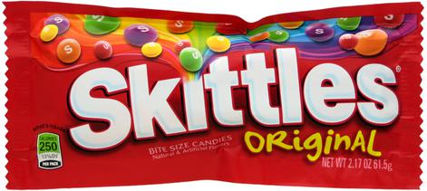

2.6.1 Warm-Up: Would You Rather?
Would you rather buy $8$ Skittles for $25$ cents or $62$ Skittles for $\$1.49$?
Explain your choice.
volume 1, pg. 65

Slide 7
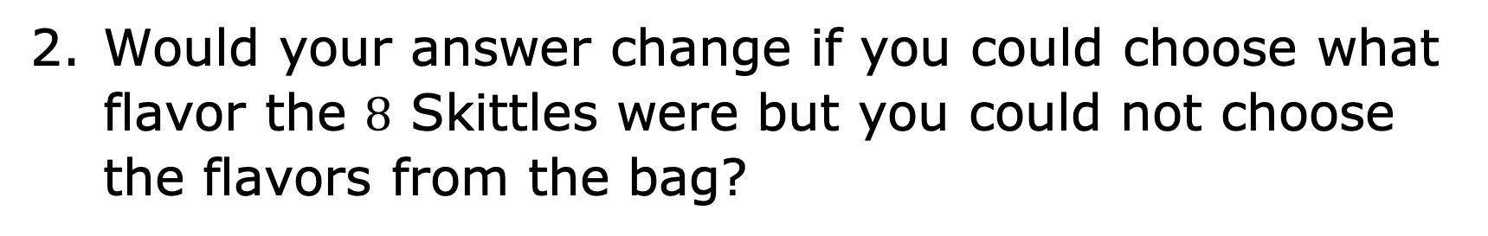
Would your answer change if you could choose what flavor the $8$ Skittles were but you could not choose the flavors from the bag?
volume 1, pg. 65

Slide 8

Guided Practice
volume 1, pg. 65

Slide 9

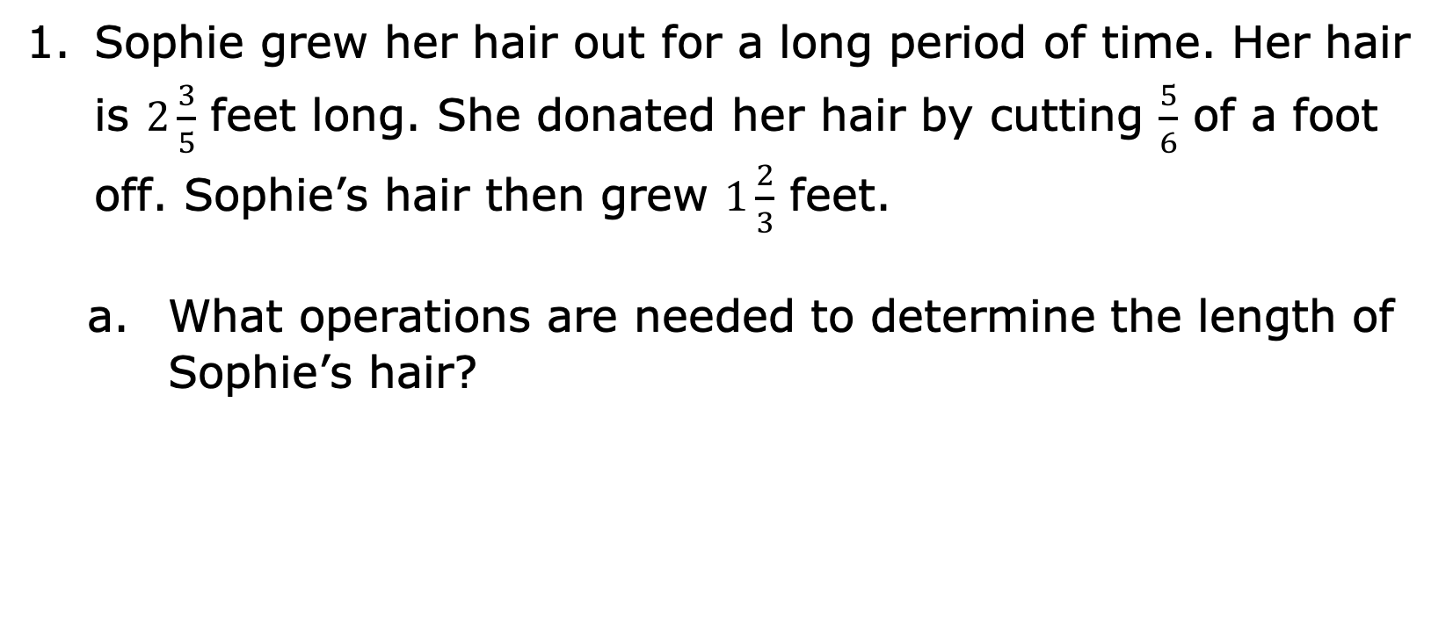
2.6.2 Guided Practice: Two-Step Rational Problems
Sophie grew her hair out for a long period of time. Her hair is $2\frac{3}{5}$ feet long. She donated her hair by cutting $\frac{5}{6}$ of a foot off. Sophie’s hair then grew $1\frac{2}{3}$ feet.
What operations are needed to determine the length of Sophie’s hair?
volume 1, pg. 65

Slide 10
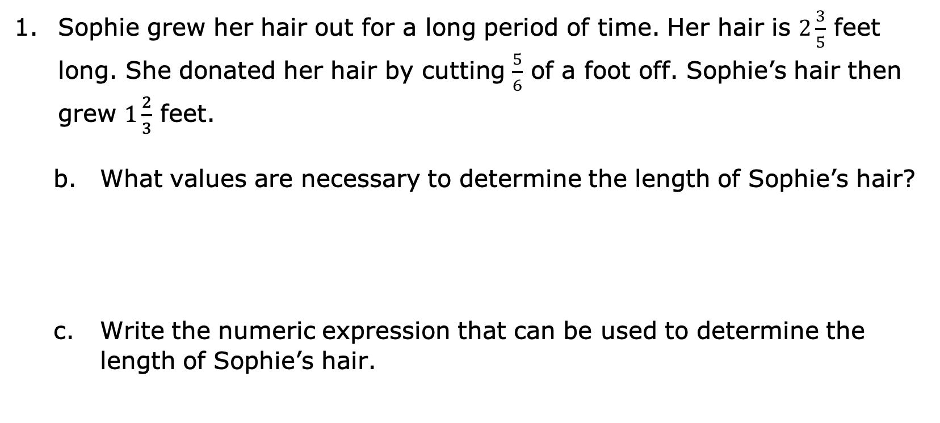
Sophie grew her hair out for a long period of time. Her hair is $2\frac{3}{5}$ feet long. She donated her hair by cutting $\frac{5}{6}$ of a foot off. Sophie’s hair then grew $1\frac{2}{3}$ feet.
What values are necessary to determine the length of Sophie’s hair?
Write the numeric expression that can be used to determine the length of Sophie’s hair.
volume 1, pg. 65

Slide 11
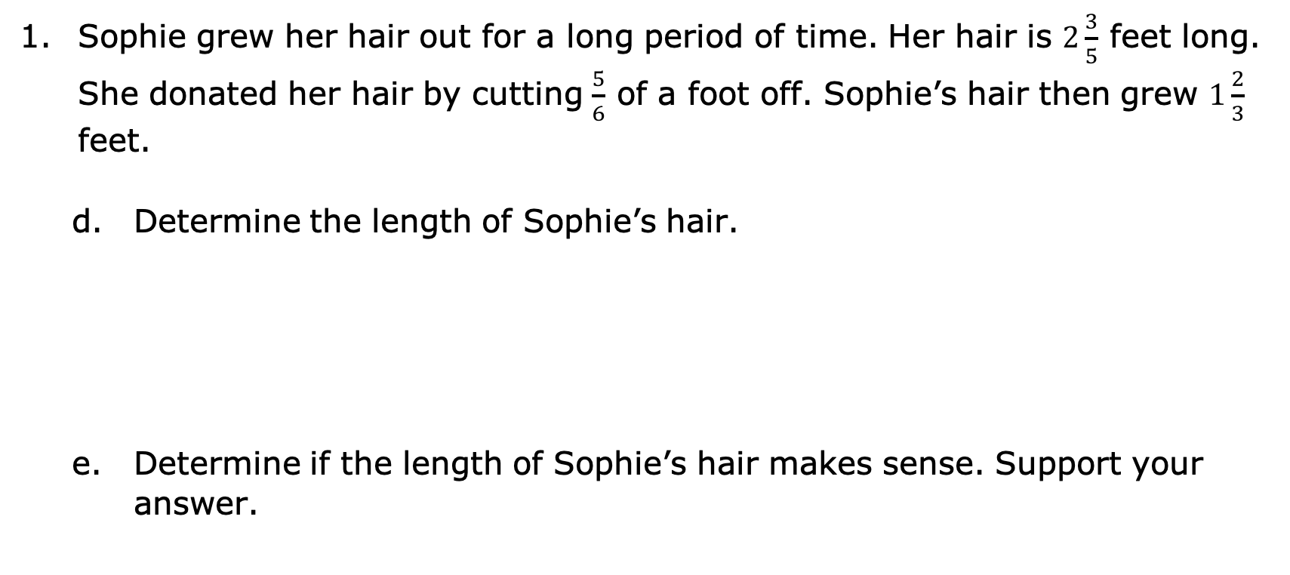
Sophie grew her hair out for a long period of time. Her hair is $2\frac{3}{5}$ feet long. She donated her hair by cutting $\frac{5}{6}$ of a foot off. Sophie’s hair then grew $1\frac{2}{3}$ feet.
Determine the length of Sophie’s hair.
Determine if the length of Sophie’s hair makes sense. Support your answer.
volume 1, pg. 65

Slide 12
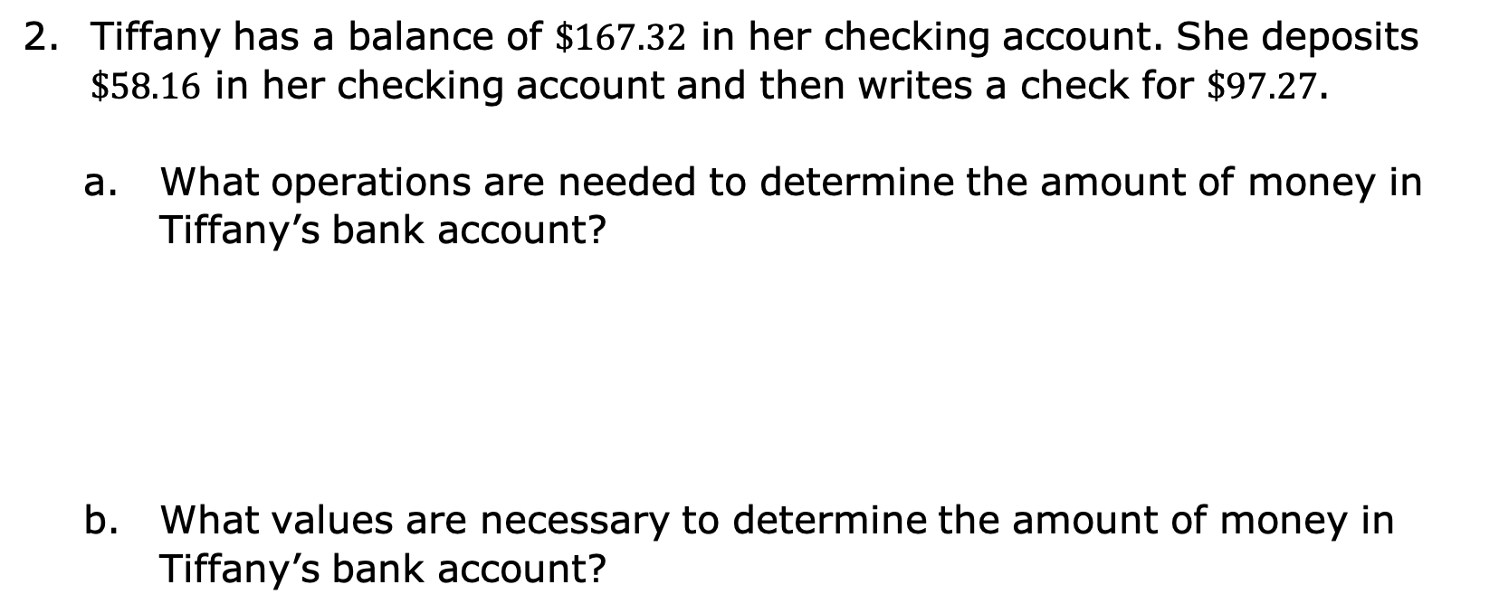
Tiffany has a balance of $\$167.32$ in her checking account. She deposits $\$58.16$ in her checking account and then writes a check for $\$97.27$.
What operations are needed to determine the amount of money in Tiffany’s bank account?
What values are necessary to determine the amount of money in Tiffany’s bank account?
volume 1, pg. 66

Slide 13
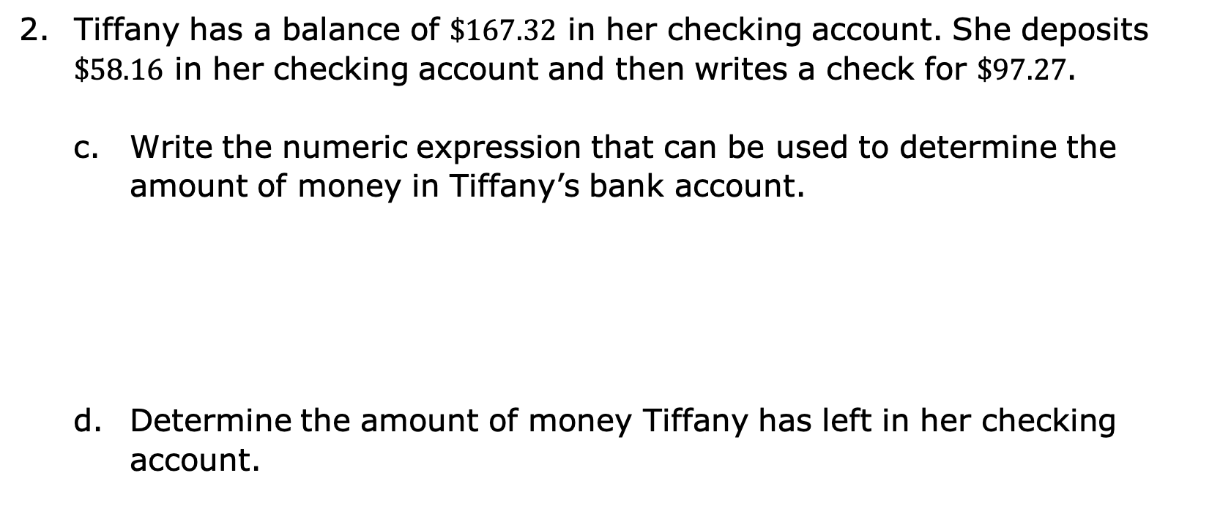
Tiffany has a balance of $\$167.32$ in her checking account. She deposits $\$58.16$ in her checking account and then writes a check for $\$97.27$.
Write the numeric expression that can be used to determine the amount of money in Tiffany’s bank account.
Determine the amount of money Tiffany has left in her checking account.
volume 1, pg. 66

Slide 14

Collaboration
volume 1, pg. 66

Slide 15

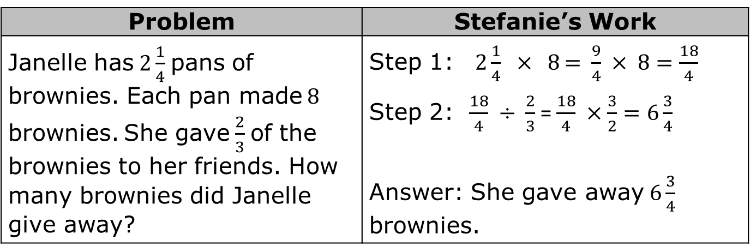
2.6.3 Collaboration: Error Analysis
Stefanie solved the following word problem. Her work is shown.
Evaluate her work and determine where she made mistakes.
Problem | Stefanie’s Work
Janelle has $2\frac{1}{4}$ pans of brownies. Each pan made $8$ brownies. She gave $\frac{2}{3}$ of the brownies to her friends. How many brownies did Janelle give away? | Step 1: $2\frac{1}{4} × 8$ =$\frac{9}{4} × 8=\frac{18}{4}$ Step 2: $\frac{18}{4} ÷ \frac{2}{3}$= $\frac{18}{4} ×\frac{3}{2}=6\frac{3}{4}$ Answer: She gave away $6\frac{3}{4}$ brownies.
volume 1, pg. 66

Slide 16
Help Stefanie understand and learn from her mistakes. Write a brief note to Stefanie explaining what her mistakes were and how she could learn from those mistakes.
Means
I
Start
To
Acquire
Knowledge
Experience
Skills
volume 1, pg. 66

Slide 17
Read your partner’s note to Stefanie and offer suggestions for how to improve their note.
volume 1, pg. 66

Slide 18

Your Turn
volume 1, pg. 67

Slide 19
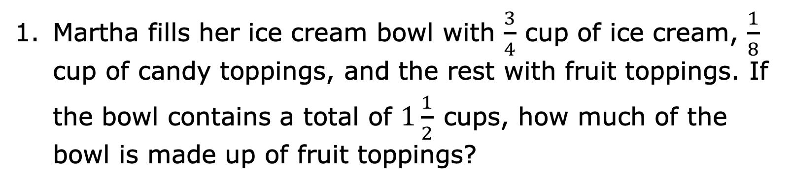
2.6.4 Your Turn!
Martha fills her ice cream bowl with $\frac{3}{4}$ cup of ice cream, $\frac{1}{8}$ cup of candy toppings, and the rest with fruit toppings. If the bowl contains a total of $1\frac{1}{2}$ cups, how much of the bowl is made up of fruit toppings?
volume 1, pg. 67

Slide 20
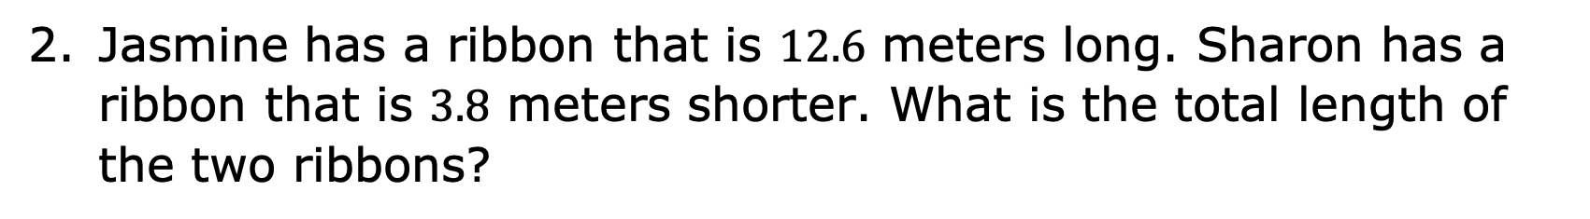
Jasmine has a ribbon that is $12.6$ meters long. Sharon has a ribbon that is $3.8$ meters shorter. What is the total length of the two ribbons?
volume 1, pg. 67

Slide 21
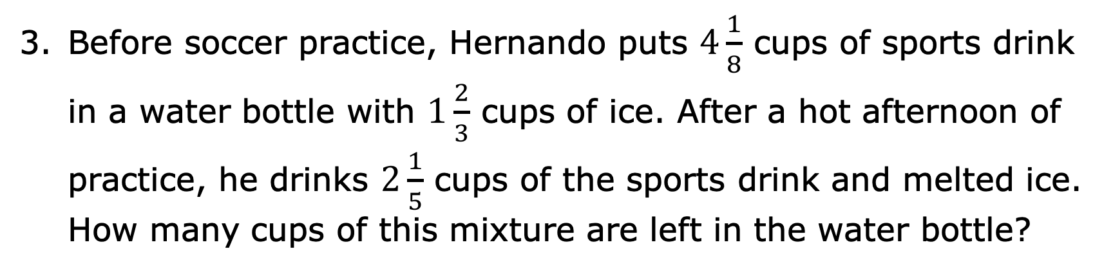
Before soccer practice, Hernando puts $4\frac{1}{8}$ cups of sports drink in a water bottle with $1\frac{2}{3}$ cups of ice. After a hot afternoon of practice, he drinks $2\frac{1}{5}$ cups of the sports drink and melted ice. How many cups of this mixture are left in the water bottle?
volume 1, pg. 67

Slide 22
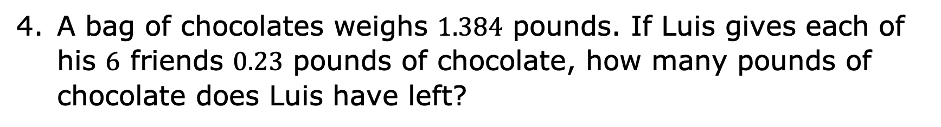
A bag of chocolates weighs $1.384$ pounds. If Luis gives each of his $6$ friends $0.23$ pounds of chocolate, how many pounds of chocolate does Luis have left?
volume 1, pg. 67

Slide 23

Wrap-Up
volume 1, pg. 68

Slide 24
2.6.5 Wrap-Up: Reflection
Place an X on the line to indicate your understanding of each of today’s learning targets. Then, provide a brief explanation or evidence to support your self-assessment.
I can solve real-world problems with two steps using decimals.
I need help. I can’t get started. | I’m getting there. | I understand and have evidence.
volume 1, pg. 68

Slide 25
Place an X on the line to indicate your understanding of each of today’s learning targets. Then, provide a brief explanation or evidence to support your self-assessment.
I can solve real-world problems with two steps using fractions.
I need help. I can’t get started. | I’m getting there. | I understand and have evidence.
volume 1, pg. 68

